Slide 1
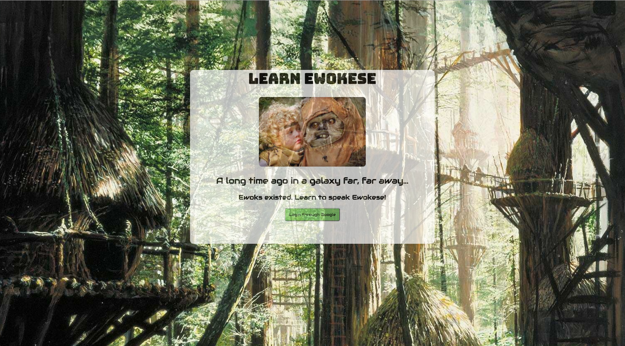

Slide 2
Stack
create-react-app
create-react-app-buildpack
Deploy to Heroku using two servers
React server
https://enigmatic-refuge-11264.herokuapp.com/#/
Express server
Mlabs mongodb

Slide 3
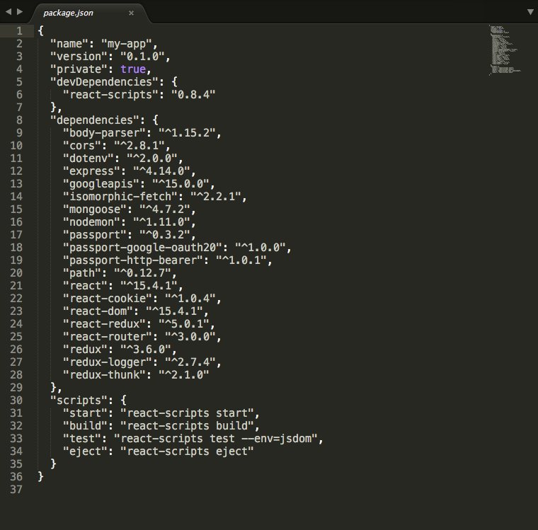
Dependencies - React

Slide 4
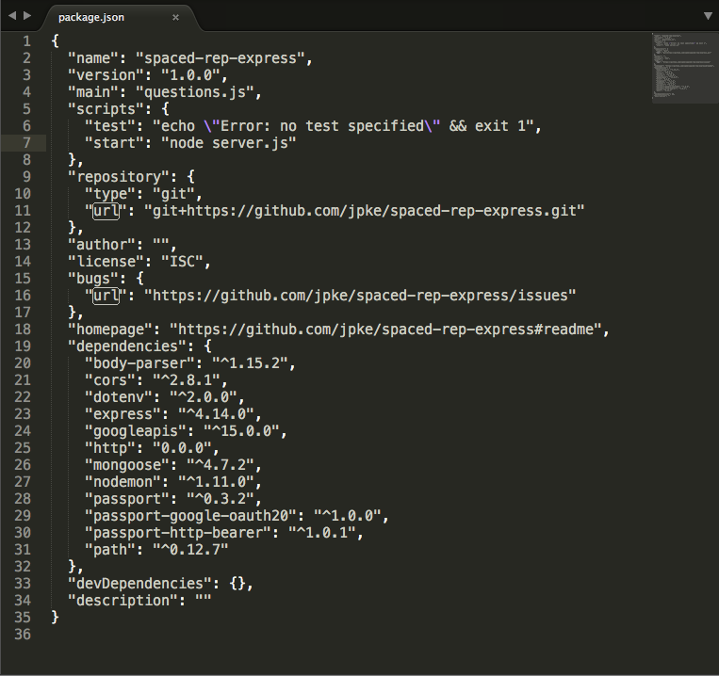
Dependencies - Express

Slide 5
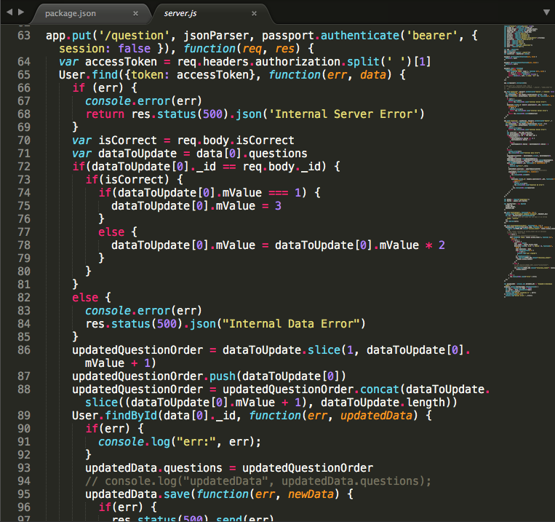
Algorithm

Slide 6
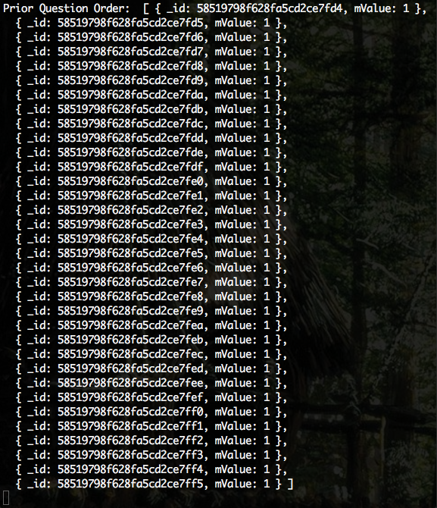
Initial Question Order

Slide 7
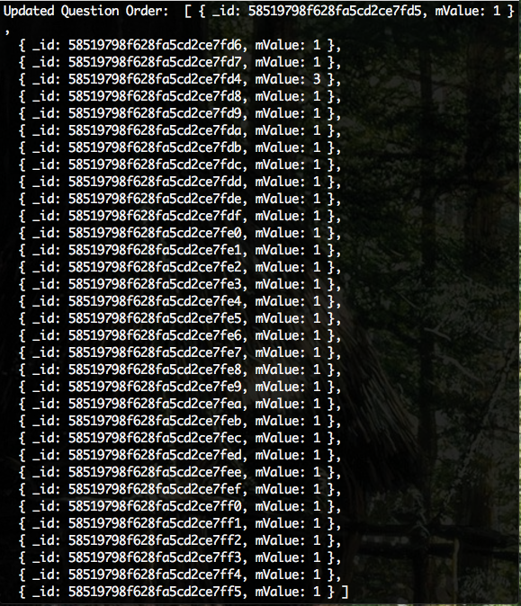
After Correct Answer

Slide 8
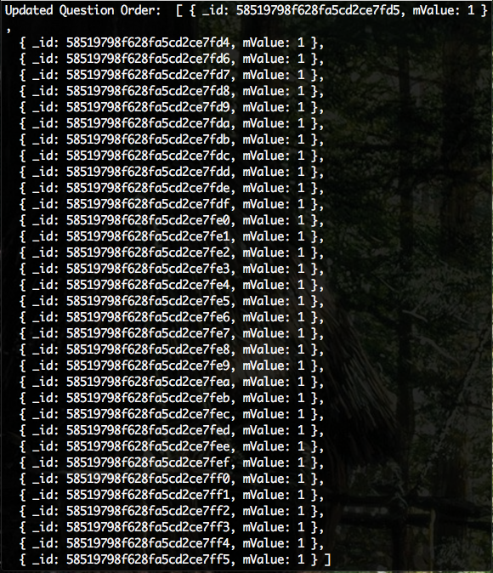
After Incorrect Answer

Slide 9
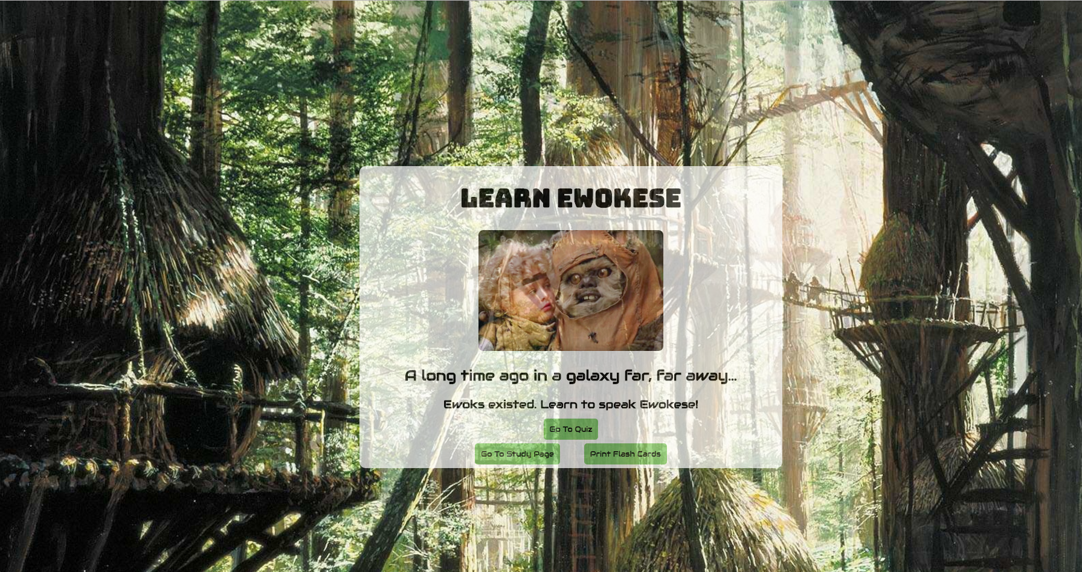

Slide 10


Slide 11


Slide 12
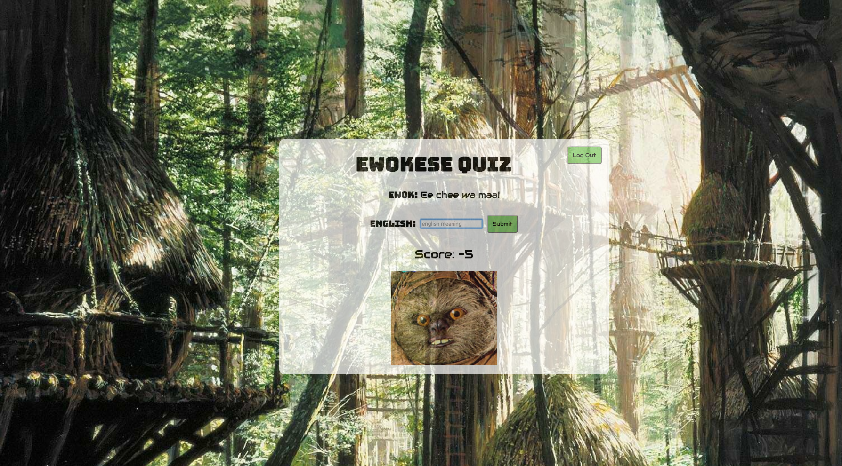

Slide 13
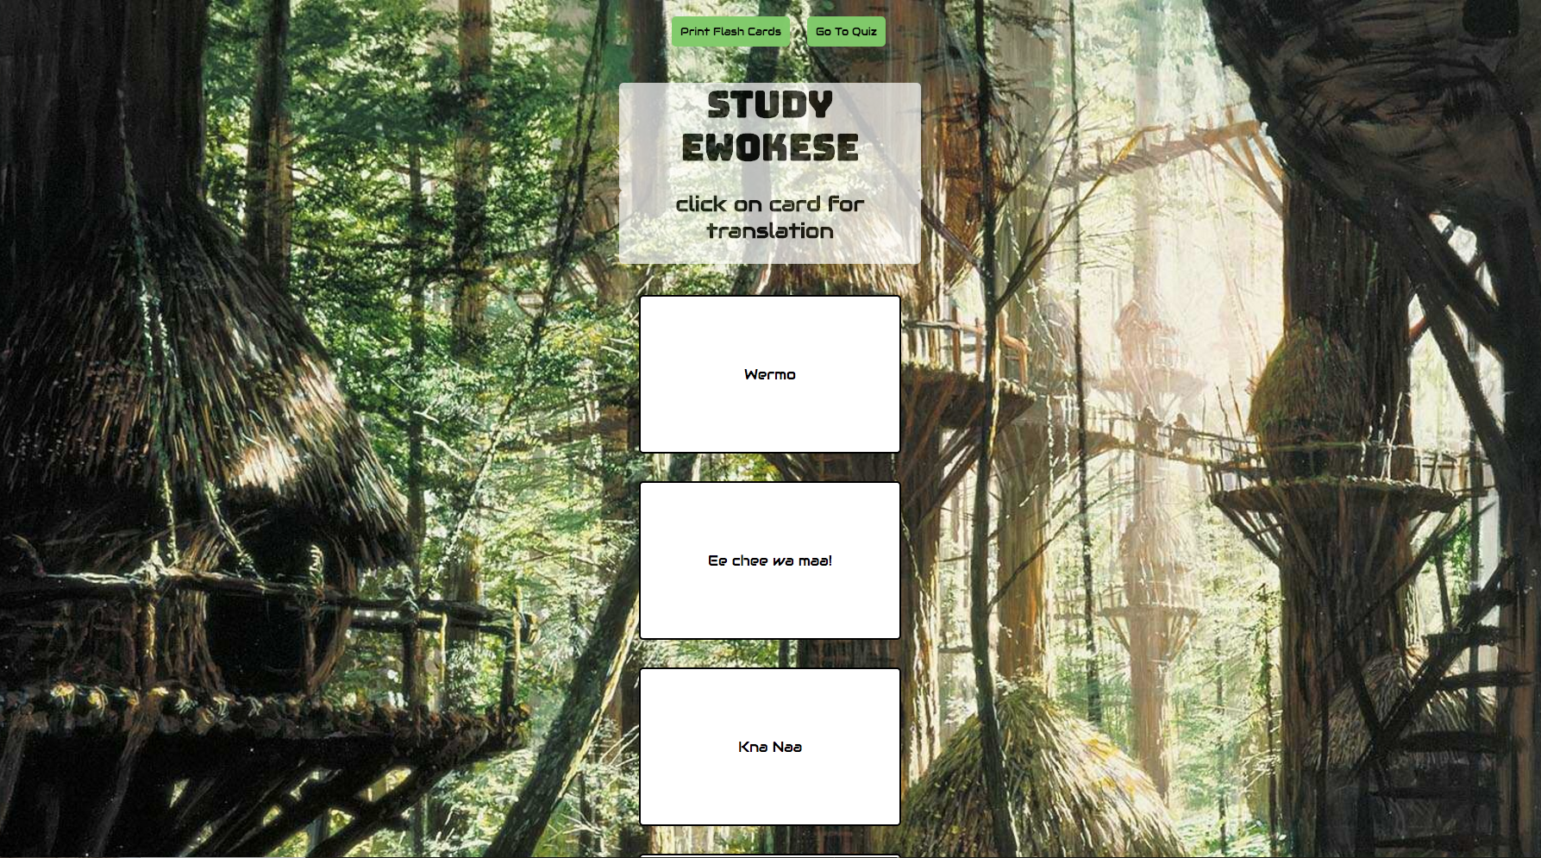

Slide 14
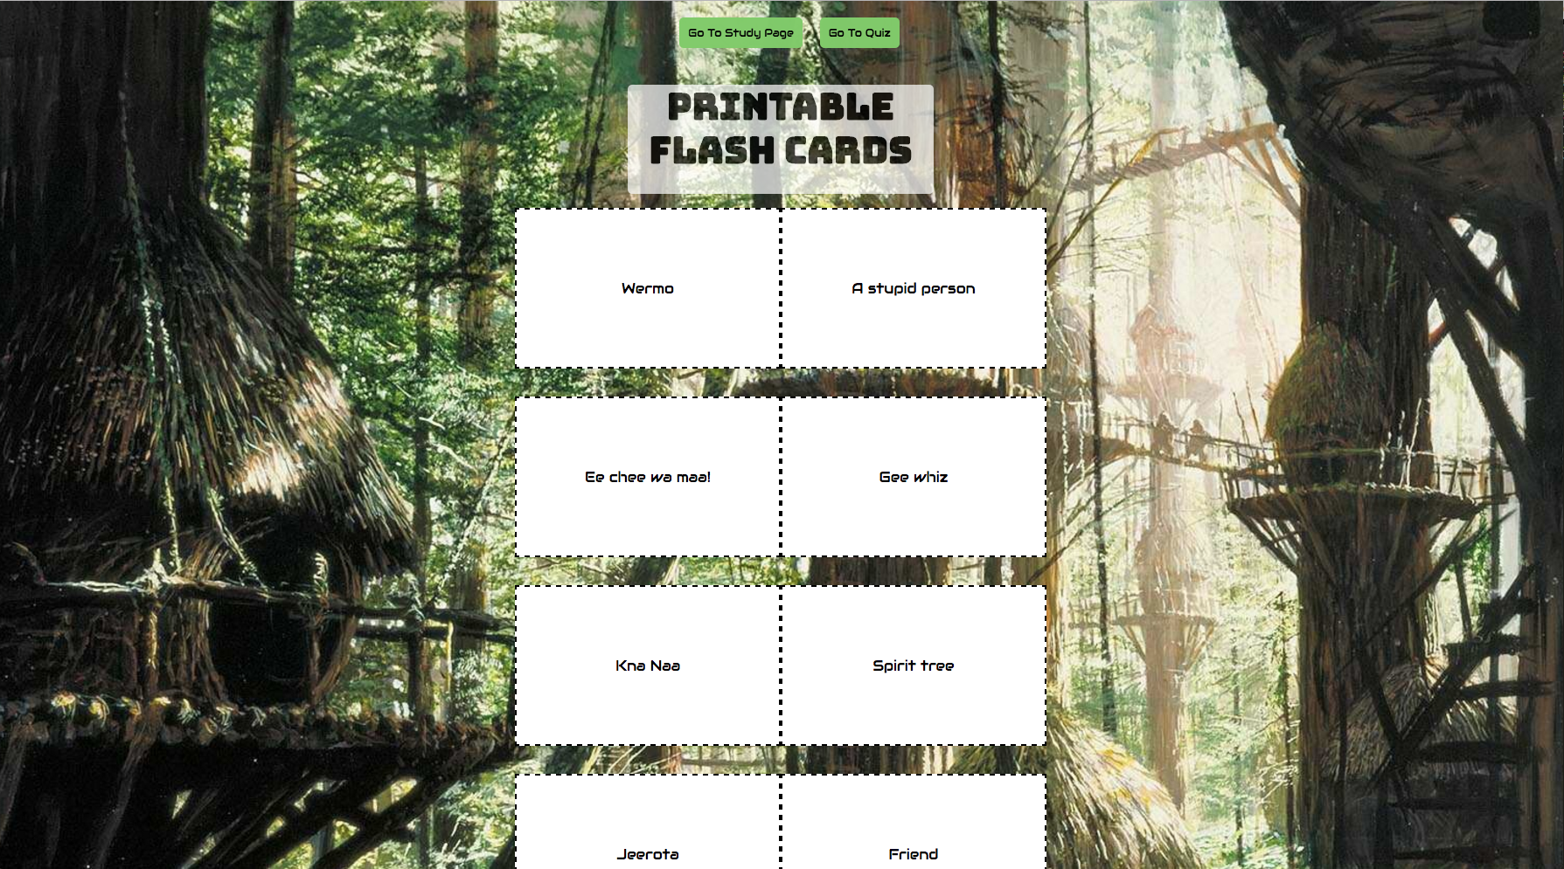

Slide 15
Lessons Learned
Be familiar with build system and how it deploys before using
Fluent in Ewokese
Different configurations for development versus production code
Greater fluency building in react
OAuth2.0 implementation

Slide 16

YEHA

